Slide 1

Speak fluently
Intermediate

Slide 2
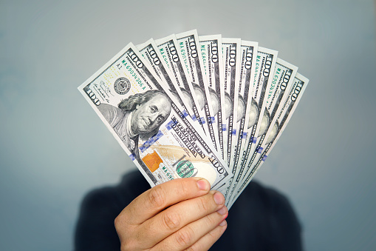
19. Money

Slide 3
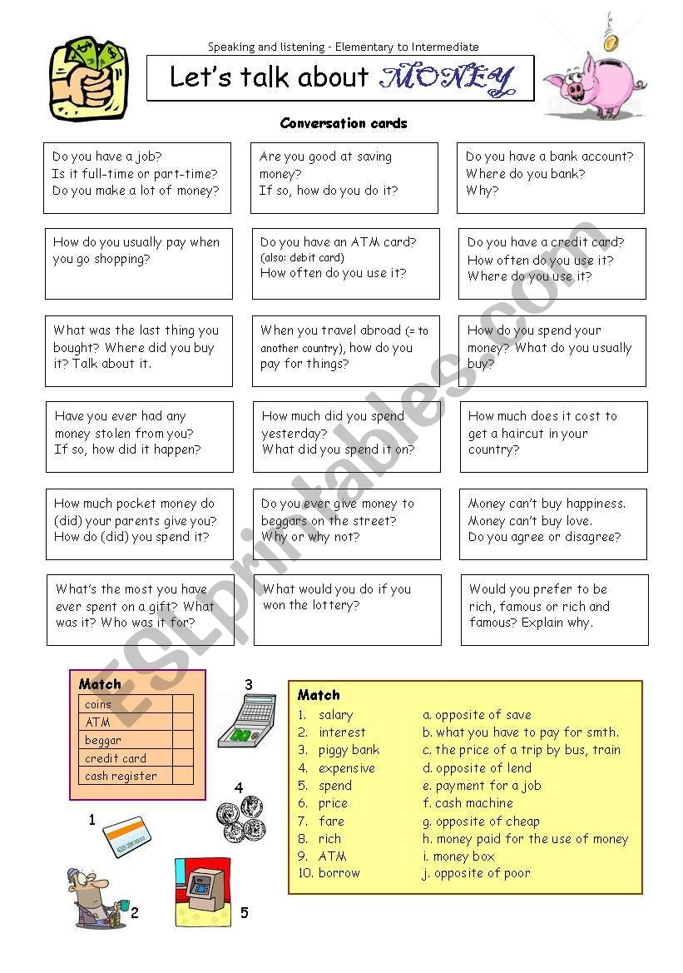












19. Money
Comments:

Slide 4
19. Money
What comes to mind when you hear the word ‘money’?
2) Does money make the world go round?
3) Does ‘money talk’? (used to say that money has a strong influence on people's actions and decisions In politics, money talks.)
4) What would life be like without money?
5) How often do you think about money?
6) What does the expression, “money doesn’t grow on trees” mean?
7) What would life be like if it did?
8) Who and why might someone ask, “Do you think I’m made of money” (= to have a lot of money)Have you ever asked this?
9) How would the world be different if all the money in the world was shared out equally among all people?
10) What’s the best way of making a lot of money?

Slide 5
19. Money
10) Have you ever raised money for charity?
11) How important is money to you?
12) Is money really the root of all evil?
13) Can money buy happiness?
14) Do you worry about money?
15) What’s the largest amount of money you’ve ever had in your wallet/purse?
16) Does having a lot of money make someone more attractive?
17) Have you ever lost a lot of money?
18) How much pocket money should a 13-year-old get?
19) Do you ever run out of money?
20) Do you agree with the idiom that “a fool and his money are easily parted” which means that a foolish person spends money too quickly on unimportant things.?

Slide 6
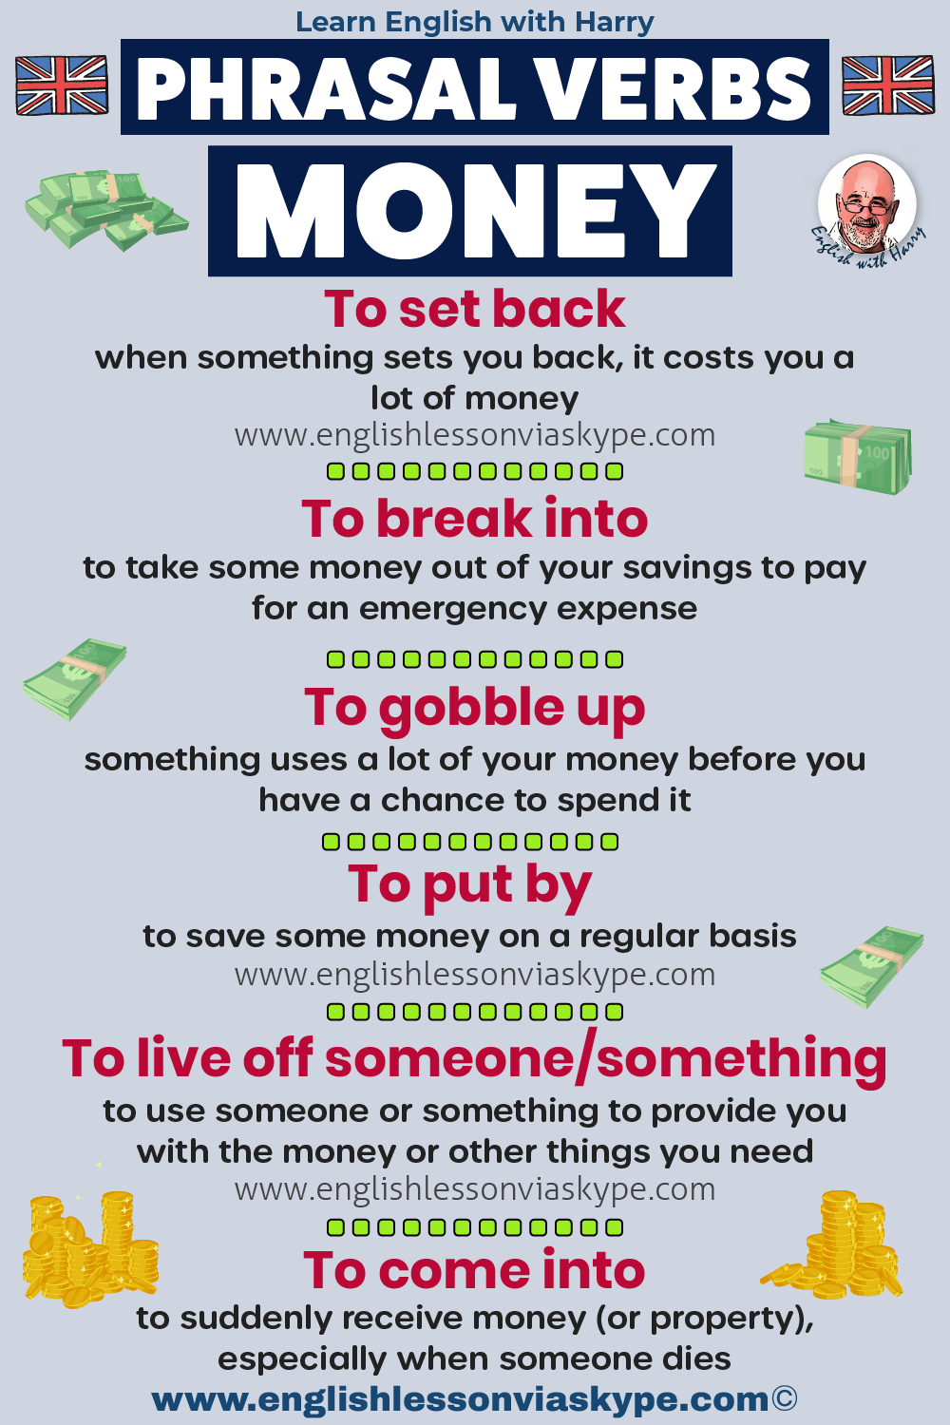
19. Money

Slide 7
19. Money
To Cough Up
Meaning: when somebody asks you to cough up, they want you to make some payment to them; to pay
Examples:
Your team has lost. Come on, cough up, you owe me €10.
That looks really nice, but how much did that cost you? How much did you cough up for this?
Somebody is going to have to cough up for this bill.
To Set Back
Meaning: when something sets you back, it costs you a lot of money
Examples:
Wow, a new camera! That must have set you back a lot of money.
This cruise holiday is going to set us back quite a lot of money.
English Expression:
to set you back a pretty penny
To Run Through (Their Money)
Meaning: to spend money quickly
Examples:
My kids run through their pocket money very quickly; after 2 or 3 days, they come back asking for more.
I got €100 as a gift for my birthday, I ran through it so quickly.
To Break Into
Meaning: to take some money out of your savings to pay for an emergency expense
Examples:
Last week my fridge broke down. I had to break into my savings to repair it.
I hate having to break into my savings, but what am I going to do? The car broke down just when you didn’t want it to happen.
Here I have to break into my savings yet again and put off those holidays for another day.
To Roll In
Meaning: to have plenty of money to throw around; arrive in great numbers or quantity
Examples: She is always out there spending money; she must be rolling in it.
To Work Off (The Debt)
Meaning: if you work off your debt, you find some way to repay your debt when you don’t have any money
Examples:
Back in the day, my grandad worked off his debt by working in the kitchen.
My parents paid half of the deposit for the car; I guess I’ll have to work it off during the summer holidays.

Slide 8
19. Money
To Live Off Someone
Meaning: to use someone or something to provide you with the money or other things you need
Example:
I’m tired of Adam living off us. When is he going to find a proper job and move out? Seems to be going on forever.
He retired at the age of 70 and now lives off his pension.
Some people in the UK live off the benefits that the state provides them.
To Come Into
Meaning: to suddenly receive money (or property), especially when someone dies
Examples
I came into some money recently. My elderly aunt died and has left me a thousand euro. I can now upgrade my laptop.
His family came into real wealth after winning the top prize in the Euromillions.
To Gobble Up
Meaning: something uses a lot of your money before you have a chance to spend it
Examples:
Slot machines in the casino gobble up your money very quickly.
Before I knew it, the machine gobbled up €20.
Higher electricity costs gobble up my money every month.
The taxman gobbles up over 40% of my money.
To Put By
Meaning: to save some money on a regular basis
Example:
I like to put by some money for the kids’ education.
To Square Up
Meaning: to settle for some payment somebody made on your behalf when you didn’t have any money on you (usually a small payment); to give back the money that you’ve borrowed
Example:
I’ve left my wallet at home. Could you please pay the entrance fee for me? I’ll square up with you later. I hate owing money to anybody.
give somebody a digout – to lend someone money when they need it

